Slide 1
Chapter 5 Loops
Liang, Introduction to Java Programming, Tenth Edition, (c) 2015 Pearson Education, Inc. All rights reserved.

Slide 2
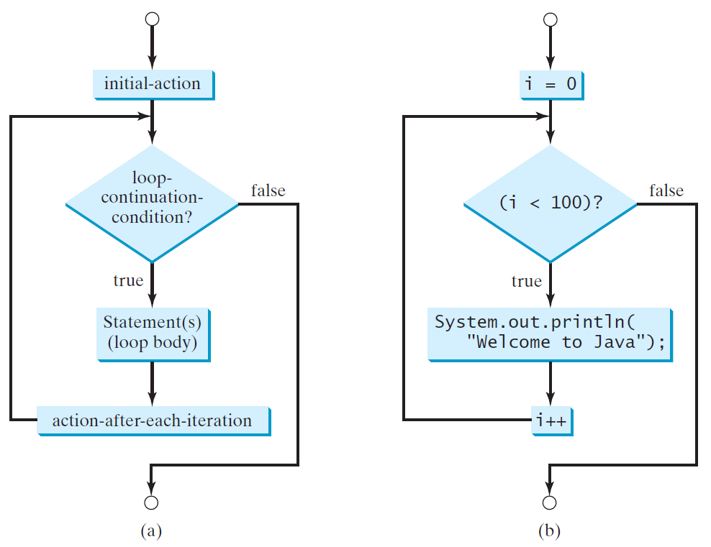
for Loops
for (initial-action; loop-continuation-condition; action-after-each-iteration) {
// loop body;
Statement(s);
}
int i;
for (i = 0; i < 100; i++) {
System.out.println(
"Welcome to Java!");
}

Slide 3
SubtractionQuizLoop.java
Pages 166-7 Listing 5.4

Slide 4
SubtractionQuizLoop2.java
With a for loop

Slide 5

Note
If the loop-continuation-condition in a for loop is omitted, it is implicitly true. Thus the statement given below in (a), which is an infinite loop, is correct. Nevertheless, it is better to use the equivalent loop in (b) to avoid confusion:

Slide 6
TemperatureTable2.java
{
System.out.println("Celsius\tFahrenheit");
for (long celsius = 0; celsius <= 30; celsius += 5 ) {
long fahrenheit = Math.round(1.8 * celsius + 32);
System.out.println(celsius + "\t\t\t" + fahrenheit);
}
}

Slide 7
Caution
Adding a semicolon at the end of the for clause before the loop body is a common mistake, as shown below:
Logic Error
for (int i=0; i<10; i++);
{
System.out.println("i is " + i);
}

Slide 8
Nested Loops
Problem: Write a program that uses nested for loops to print a multiplication table.
MultiplicationTable
Run

Slide 9
MultiplicationTable.java
Pages 178-9 Listing 5.7

Slide 10
Minimizing Numerical Errors
Numeric errors involving floating-point numbers are inevitable. This section discusses how to minimize such errors through an example.
Here is an example that sums a series that starts with 0.01 and ends with 1.0. The numbers in the series will increment by 0.01, as follows: 0.01 + 0.02 + 0.03 and so on.
TestSum
Run

Slide 11
Problem: Predicting the Future Tuition
Problem: Suppose that the tuition for a university is $10,000 this year and tuition increases 7% every year. In how many years will the tuition be doubled?
FutureTuition
Run

Slide 12
Problem: Predicating the Future Tuition
double tuition = 10000; int year = 0 // Year 0
tuition = tuition * 1.07; year++; // Year 1
tuition = tuition * 1.07; year++; // Year 2
tuition = tuition * 1.07; year++; // Year 3
...

Slide 13
FutureTuition.java
Page 184 Listing 5.10

